Slide 1
Cultural Influences on Marketing Strategies

Slide 2
Cultural
Culture is defined as the collective mental programming of the human mind which distinguishes one group of people from another. This programming influences patterns of thinking which are reflected in the meaning people attach to various aspects of life and which become crystallized in the institutions of a society.“ (Geert Hofstede, 1970)
Six Dimensions of Culture
  Power distance
  Individualism
  Masculinity
  Uncertainty avoidance
  Long-term orientation
  Indulgence

Slide 3
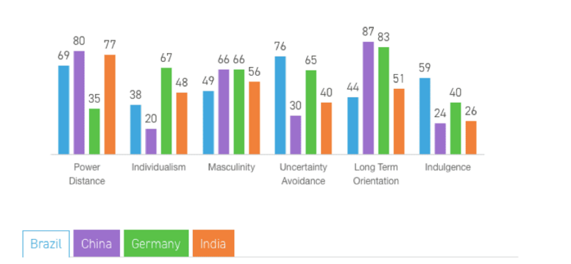
Cultural

Slide 4
Cultural Impact
To develop a successful marketing strategy, an organization must take into consideration the cultural influences of the society where a new product is being introduced. People make decisions about consumption of a product based on these cultural influences.
Cultural Values of a Society
Cultural Values can Vary Within a Country
Symbols and Symbolism
Rituals Play a Role
Thought Processes can Vary Among Cultures
Source: University of Delaware; Consumer Buying Behavior; Alex Brown
Rutgers University; Consumer Behavior Culture and Subculture; Carol Kaufman-Scarborough, Ph.D.

Slide 5
Cultural Impact
Elements of Culture
Language
  Verbal language
  Non-Verbal language
Communal Institutions
Education
Values and Attitudes
Aesthetics
Religion
Cultural Norms

